Slide 1





THE RESPIRATORY SURVEILLANCE SYSTEM IN MADAGASCAR
Norosoa RAZANAJATOVO, PhD, NIC Technical Leader

Slide 2
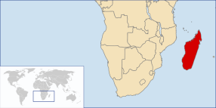
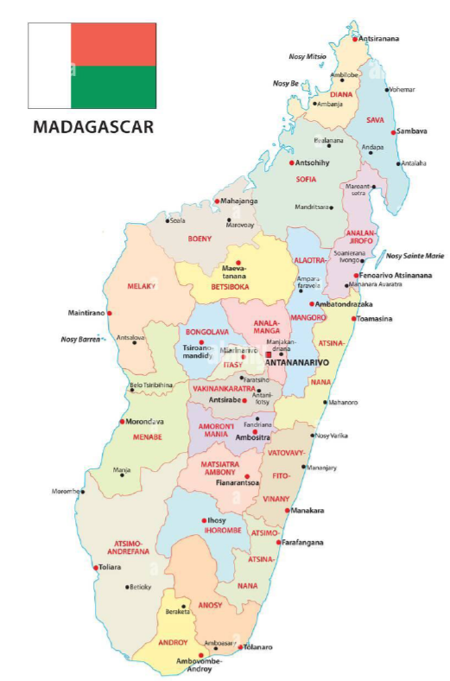
Madagascar Factsheet
Geographical location:
Island located in the Indian Ocean off the Eastern coast of Southern Africa
Separated from the African continent by the Mozambique Channel
Estimated population: 30.3 millions (in 2023)
23 Regions, 114 Districts
Capital: Antananarivo
5 bioclimates: per humid, humid, mountain, sub humid, semi arid
Currency: Ariary
Language: Malagasy ☺, French ☺, English 😐

Slide 3
History of the Respiratory Surveillance in Madagascar
Site extension
(31 ILI , 5 SARI, 6 mortality sites)
Recognition of the IPM lab as NIC by MoH and WHO
Implementation of a biological surveillance of SARI
(one site: Cenhosoa)
Transition to CSB_R led by MoH
Biological Surveillance System
Integrate several diseases
2nd SARI extension
(+one site)
ILI extension
(+20 CSB_R)
1978
2007
2010
2016
2018
2020
2021
2022
2023
2024
Progressive Extension of the network
(≈5% of total inhabitant)
Implementation of Mortality surveillance
1st SARI extension (+one site)
3rd SARI extension
(+two sites)
Implementation of RSV surveillance
Implementation of Avian flu surveillance
Implementation of a clinical SARI surveillance
Integrated Surveillance FLU/SC2
Mortality site extension
(6th District of Tana)
A network composed of 6 sites in Tana
11 ILI sites; 1 SARI site;
5 mortality sites

Slide 4
Biological Sentinel Surveillance System
MoPH (+Min. Livestock)
lead and manage the surveillance system
Develop actions
reorient public health policies if needed
organize meeting, site visit, new implementation, etc…
disseminate newsletter
IPM
NIC
EPI
CSB_R
Hospital
collect clinical data
report/notify case by “e-IDSR”
collect biological sample related to the cases
Lab testing
Data management
develop and share : study protocol, questionnaire, SOP, reports, results
participate in site visit, outbreak investigation

Slide 5
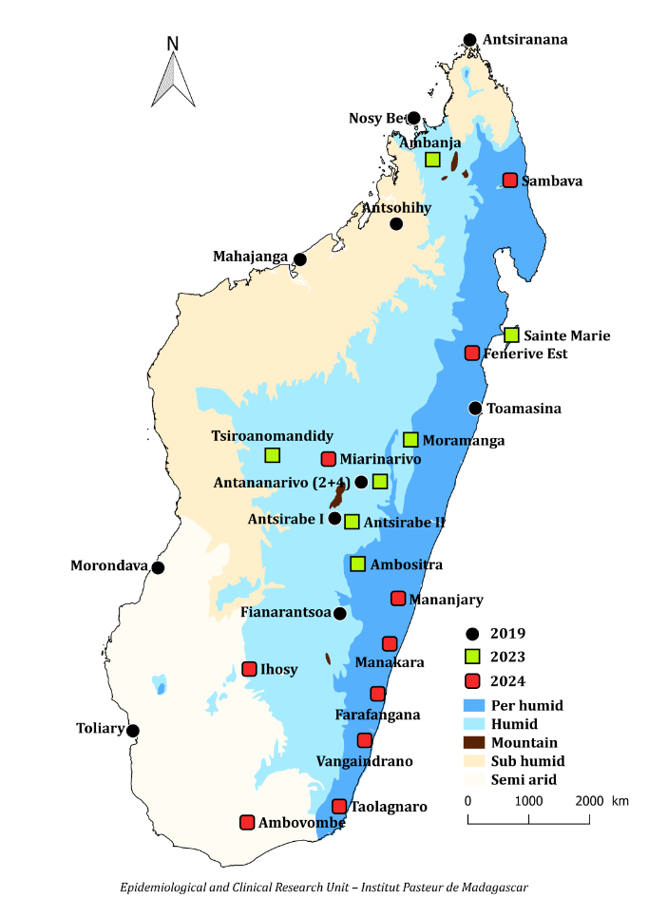
Biological Sentinel Surveillance System
Respiratory surveillance:
31 ILI sites
5 SARI sites
Geographical location of the Biological Sentinel Surveillance sites, Madagascar, 2025

Slide 6
ILI Surveillance
SARI/RSV Surveillance
Epi Surv
(all HCC)
Viro Surv
(31 HCC_R)
Respiratory
Sentinel Surveillance System
Epi Surv
(all hosp)
Viro Surv
(5 hospitals)
Collect epi data
Collect 5 specimen/wk
Collect epi data
Collect all specimen/wk
Monitor Flu, SC2
Monitor Flu, SC2, RSV, HRV, HMPV
Mortality Surveillance
Animal Surveillance
6 Districts of Tana
3 markets inTana
Wild birds
Wild lakes water
Monitor mortality due to ARI
Monitor avian Flu

Slide 7
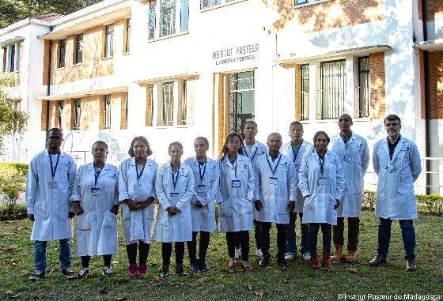
NIC lab staff in 2025, 15 people
1 NIC Director (coming soon)
1 NIC Deputy head/Technical Leader
2 Coordinators (1 medical doctor, 1 veterinarian )
1 Surveillance Officer (medical doctor)
2 Surveillance assistants
2 Engineers
5 Laboratory technicians
1 Sampler agent

Slide 8
Other staff involved in NIC activities, 6 people
1 Project managers
2 Administrative assistant
1 Data manager
2 Lab agents

Slide 9
Epi unit staff in 2025, 5 people
1 Biological Sentinel Surveillance Coordinator (Public health specialist)
1 Clinical Study Technician (Medical doctors)
2 Data managers
1 Clinical Research Manager

Slide 10
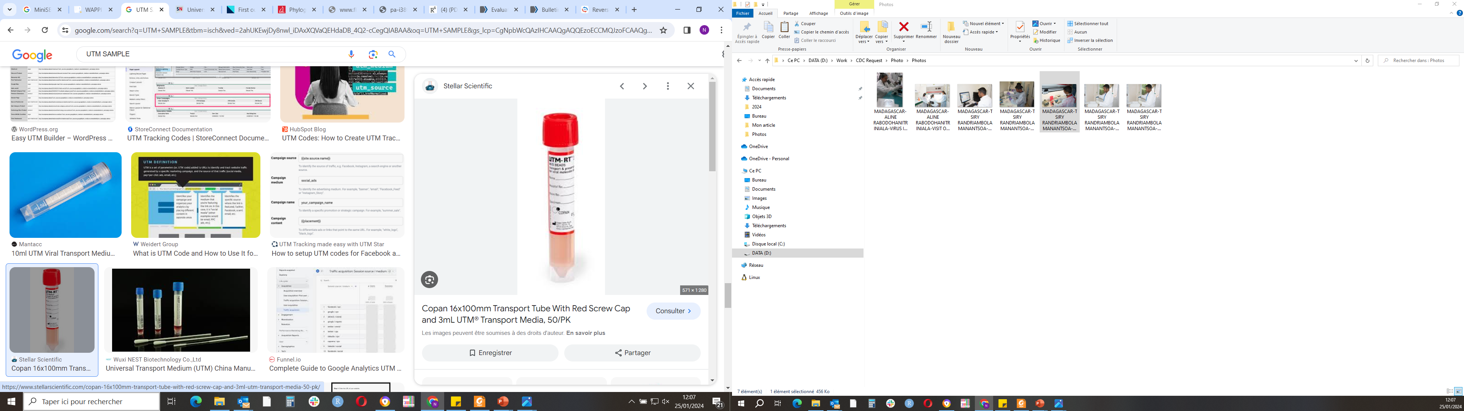
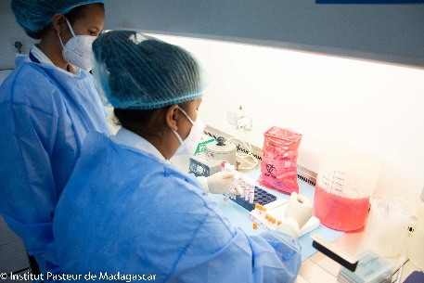
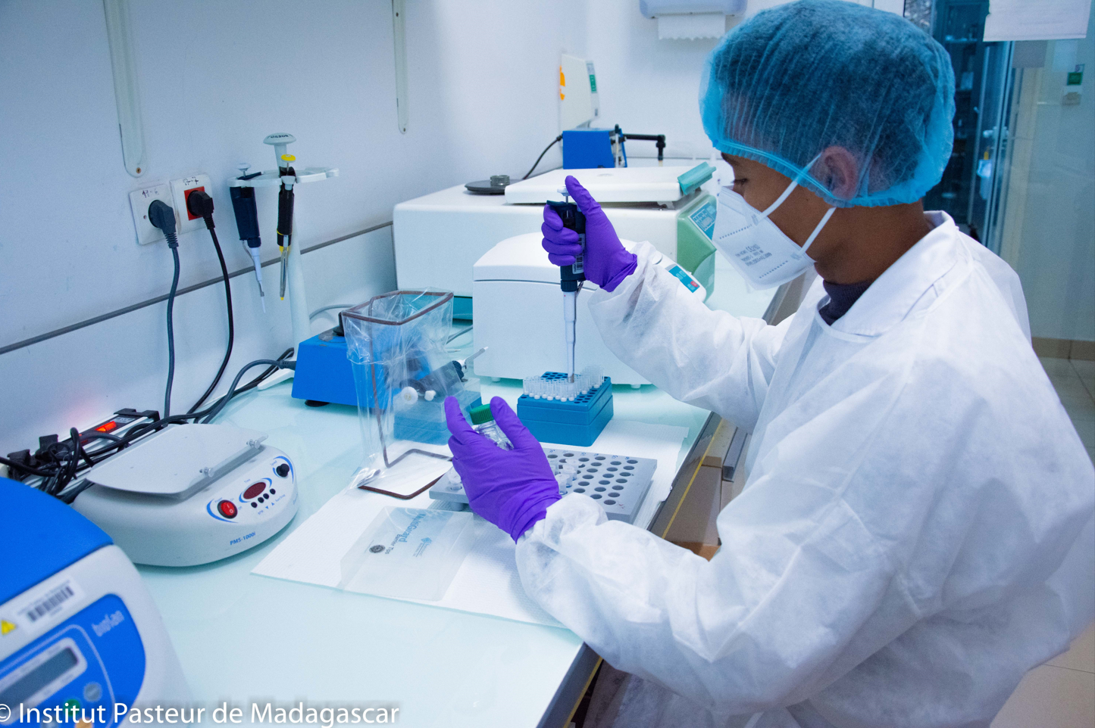
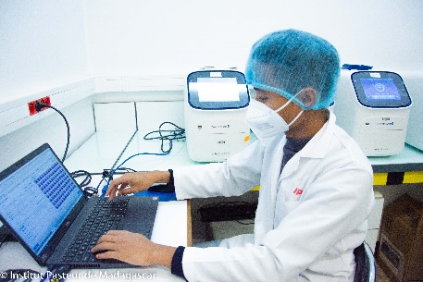
Laboratory surveillance

Slide 11

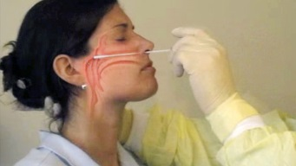
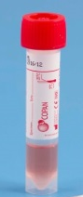
Algorythm of sample collection and testing
ILI: fever + cough + onset of disease <10 days + no hospitalization
SARI: fever + cough + onset of disease <10 days + need hospitalization
CLINICAL DIAGNOSTIC
QUESTIONNAIRE
SAMPLING
PCR influenza (A/H1dpm; A/H3; B/Vic; B/Yam
PCR influenza (A/H1dpm; A/H3; B/Vic; B/Yam
PCR RSV, Rhinovirus, HMPV
LABORATORY TESTING
PCR avian flu, MERS CoV (depending on Epi context)
PCR SARS-CoV-2

Slide 12
Human laboratory Surveillance
ILI SAMPLES
SARI SAMPLES
FLU
SARS-CoV-2
FLU
SARS-CoV-2
RSV
HRV
HMPV
If outbreak or unusual situation ➔ PCR for 14 seasonal respiratory viruses
If suspicion of zoonosis ➔ Avian flu, MERS-CoV

Slide 13
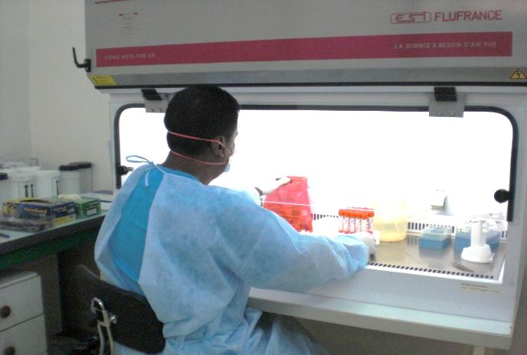
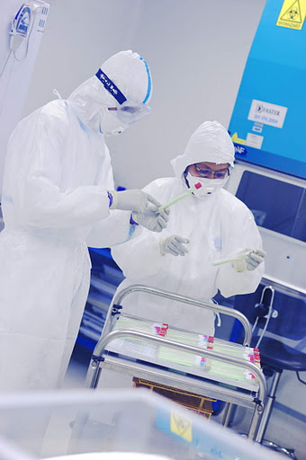
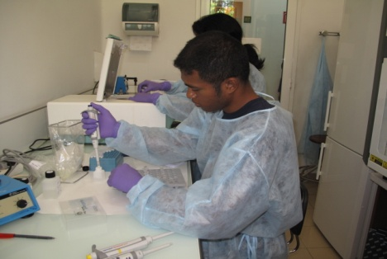
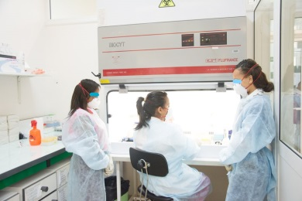
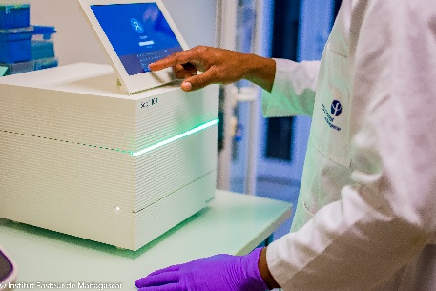
NIC Lab capacity
NSB3 Lab: cell isolation of avian Flu, SARS-CoV-2
Cell Culture : isolation of A/H1, A/H3, B in MDCK cell lines, RSV in Hep-2, HRV in MRC5, ADV in RD and Hep-2
Serology:
detection of viral Ag by HAI
detection of Ab by microneutralisation
Molecular detection
A/H1, A/H3, B/Vic, B/Yam
SARS-CoV-2
14 seasonal respiratory viruses
zoonotic viruses: avian Flu, MERS-CoV
NGS sequencing: SARS-CoV-2, RSV, FLU

Slide 14
Diagnostic kits
Virus | Kits
Influenza detection | CDC Multiplex Flu/SC2 kits from IRR
Influenza subtyping | CDC kits from IRR
SARS-CoV-2 | CDC Multiplex Flu/SC2 kits from IRR
RSV typing/subtyping | CDC kits from IRR
Avian flu | CDC kits form IRR Publication
Multiplex seasonal respiratory viruses | Developed from publications

Slide 15
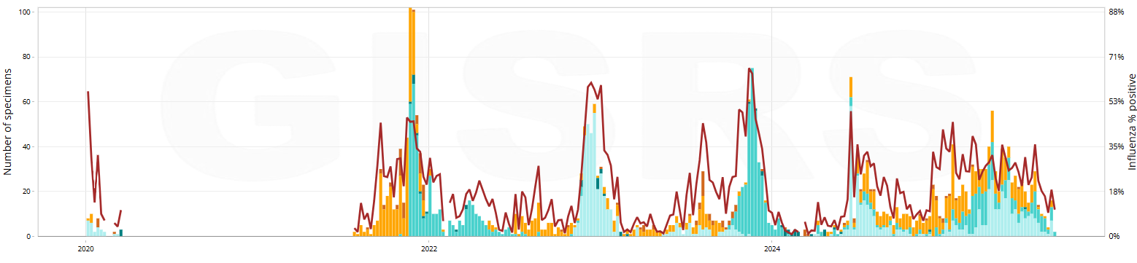
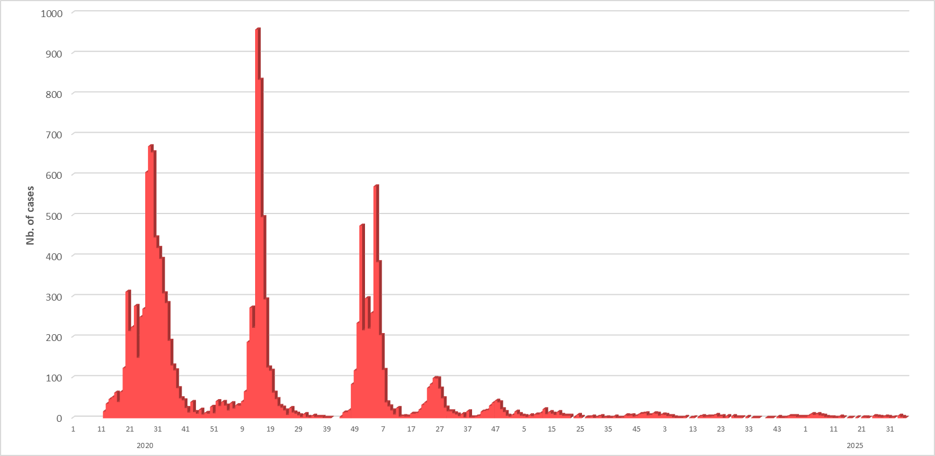
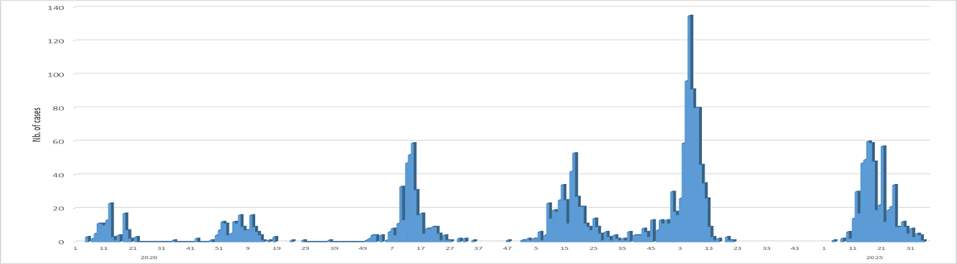
INFLUENZA
2020
2021
2022
2023
2024
2025
SARS-CoV-2
2020
2021
2022
2023
2024
2025
RSV
2020
2021
2022
2023
2024
2025
2020
2021
2022
2023
2024
2025

Slide 16
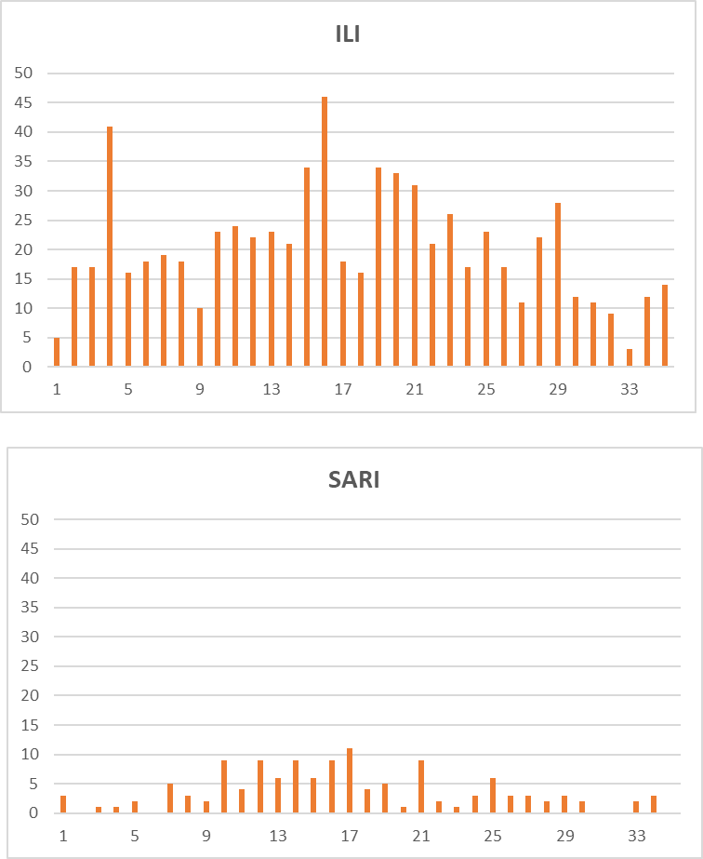
INFLUENZA, 2025

Slide 17
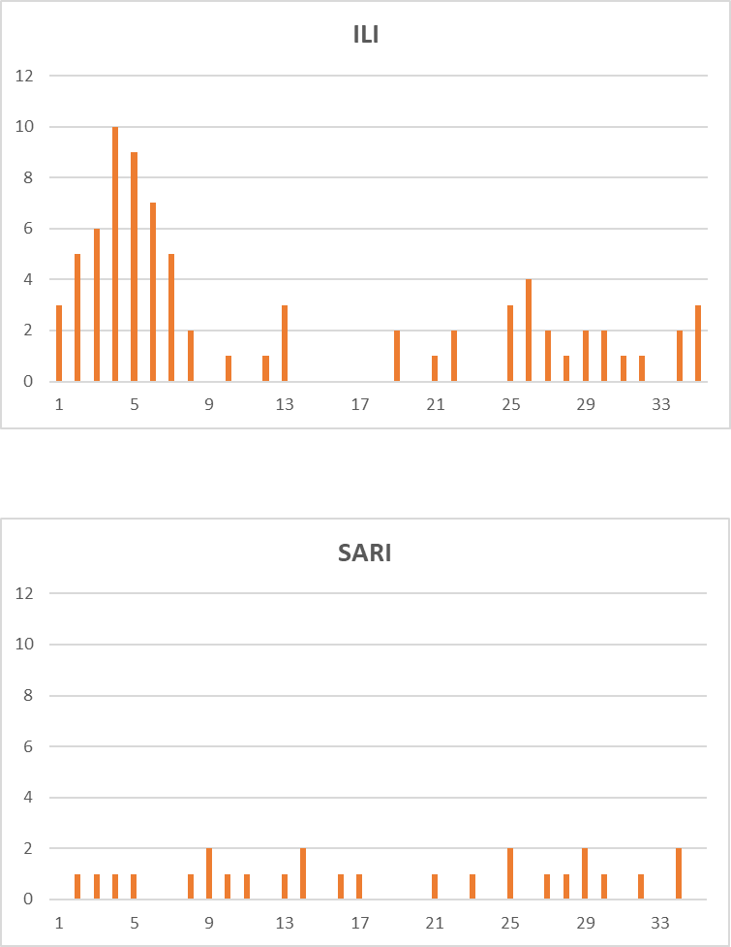
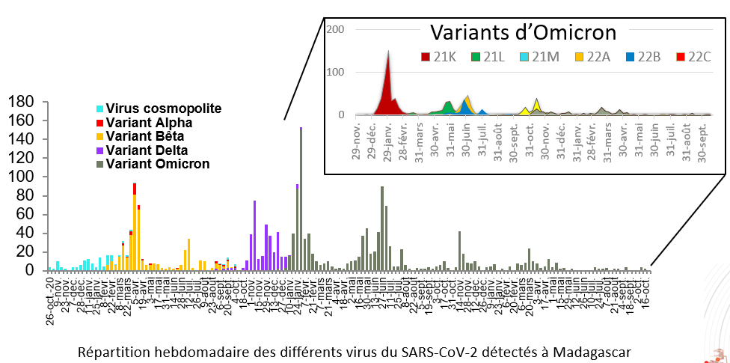
SARS-CoV-2, 2025

Slide 18
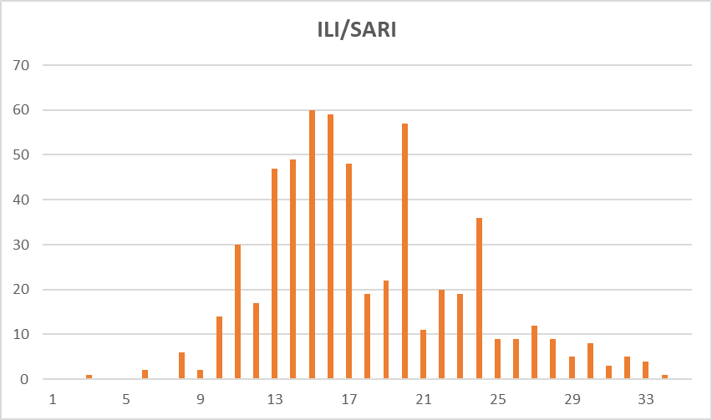
RSV, 2025

Slide 19
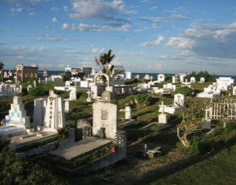


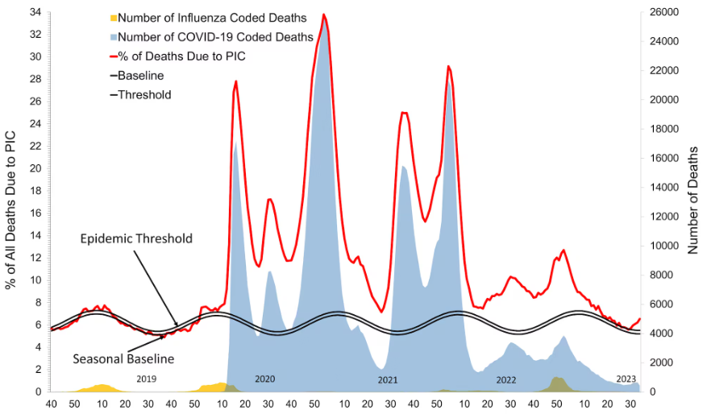
Mortality surveillance

Slide 20
Mortality surveillance
Since 2016
6 Districts of Antananarivo
Collect of mortality data via tablets
Codification of deaths according to CIM-10
2 staffs of IPM, 13 staffs of BMH and urban commune of Antananarivo

Slide 21
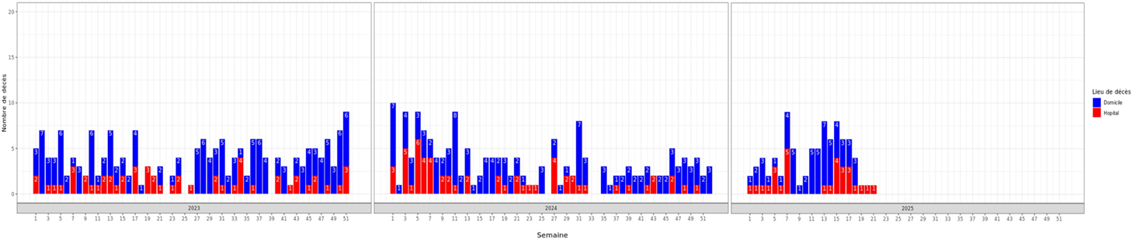
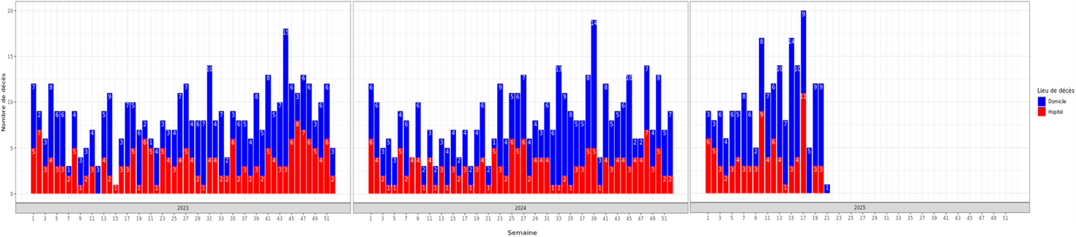
Achievements, 2023-2025
Leading causes of death from 01 January 2023 to 30 March 2025, Antananarivo
Monitoring of ARI mortality pattern via web application of urban commune of Antananarivo
Cause of death | < 5 yrs | 5-24 yrs | 25-44 yrs | 45-64 yrs | >65 yrs | Total
Stroke | 26 | 23 | 486 | 1500 | 1288 | 3323
Heart Failure | 34 | 91 | 309 | 598 | 875 | 1907
ARI (J00-J22) | 436 | 116 | 189 | 318 | 384 | 1443
All causes | 3522 | 1730 | 4931 | 8166 | 7793 | 26142
<5yrs
≥ 5yrs
In all ages, ARI ➔ 3rd cause of deaths (6% of all deaths)
In children < 5 years, ARI➔1st cause of deaths (13% of all deaths)

Slide 22
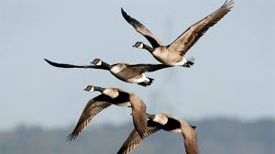
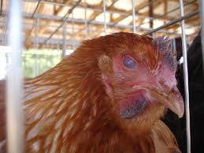

Animal surveillance

Slide 23
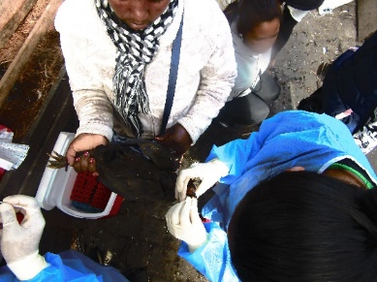
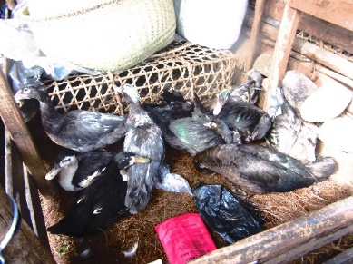
Animal surveillance
Since August 2021
In collaboration with the Ministry of Livestock and Agriculture
3 live-bird markets in Antananarivo
Sample collection on a weekly basis
Collect of throat and fecal swabs
PCR screening of influenza A
Three targeted avian influenza A subtypes: A/H5; A/H7 and A/H9
Sequencing of positive/non subtypable by NGS Illumina

Slide 24
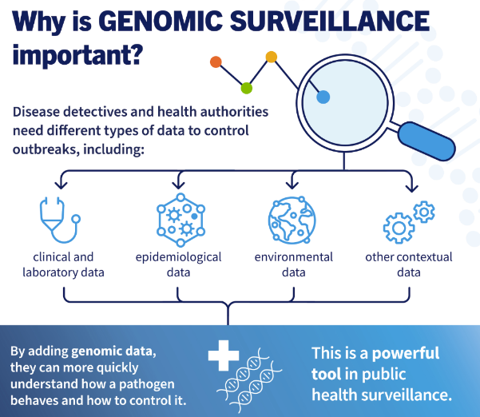
Genomic surveillance
Flu, RSV, SARS-CoV-2

Slide 25

Sequencing and Bioinformatics capacities
Three trained people
Two technologies:
Nanopore: MinION (May 2021)
Illumina: ISeq 100 (March 2020)
MiniSeq (October 2023)
Targeted sequencing/Metagenomic sequencing
Use of LIMS
Data storage: local server
Tools for analysis: pipeline
Influenza: MIRA
RSV: CZID
SARS-CoV-2: Institut Pasteur Paris

Slide 26
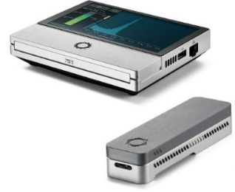
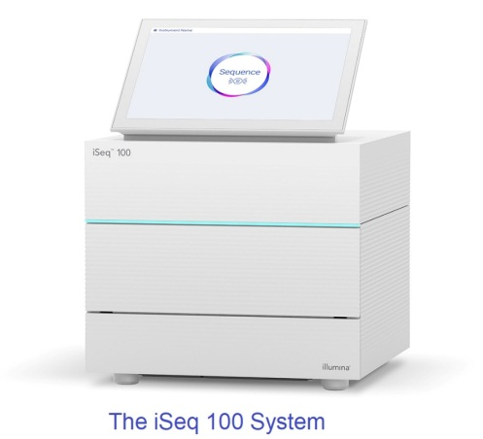
SARS-CoV-2 sequencing
July 2020: first SARS-CoV-2 sequences generated locally
Samples from SARI and ILI (selection depending on situation)
Cut off: ct=28
From July 2020-Aug 2025: 2 267 sequences generated at IPM (samples from IPM and LA2M)
Periodic sharing of sequences on GISAID (961 sequences uploaded)

Slide 27
RSV sequencing
Implemented in 2022 with Illumina (Iseq100)
Before 2025, sequencing under specific project
2025: routine sequencing under surveillance activities planned
Samples from SARI (and ILI if required)
Cut off: ct<28
184 sequences generated
Periodic sharing of sequences on GISAID (64 sequences uploaded on GISAID)
The iSeq 100 system

Slide 28

Influenza sequencing
Developed in April 2024 with MinION
Performed routinely
Samples from human (ILI and SARI) and avian
Cut off: ct<28
1769 sequences generated in country
Periodic sharing of sequences on GISAID (All sequences uploaded)
The NIC continue sending shipment to WHO CC (CDC Atlanta and the Francis Crick Institute London)
MinION

Slide 29

Reporting and Sharing

Slide 30
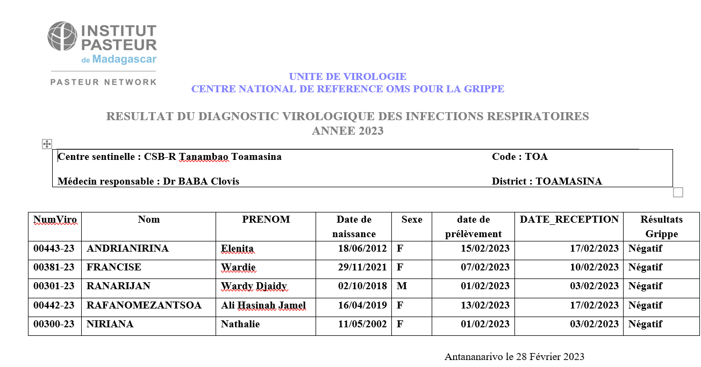
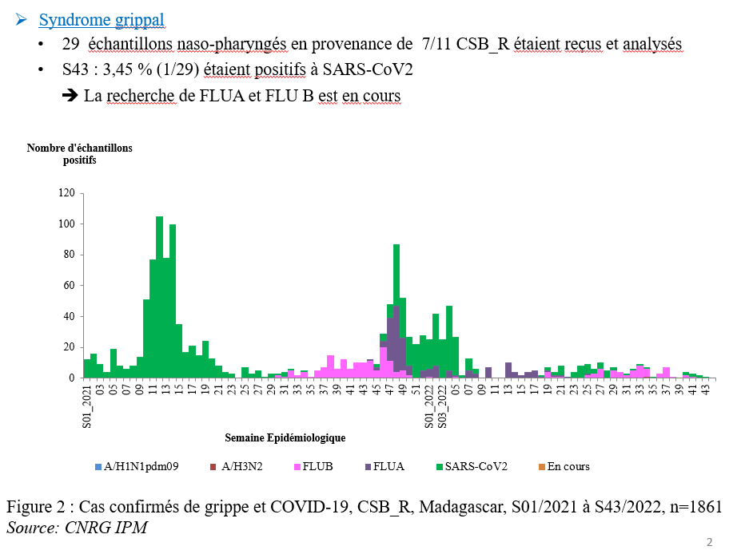
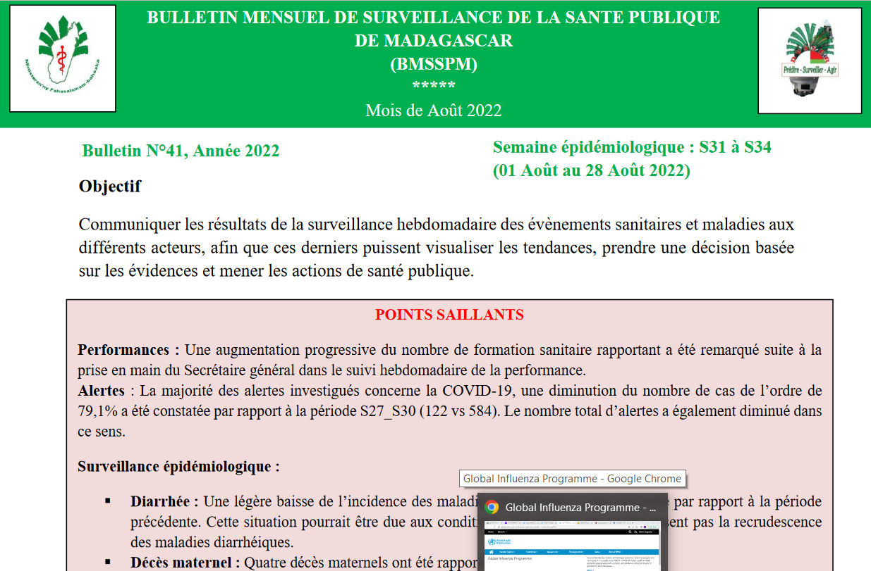
Sharing and reporting (National)
Individual report
(for Sentinel sites)
Weekly report
(for MoH)
IDSR Monthly report
(for MoH and local partners)

Slide 31
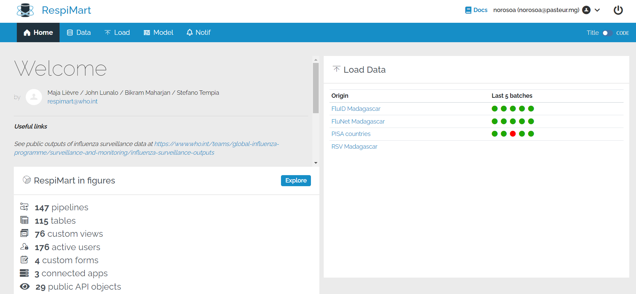
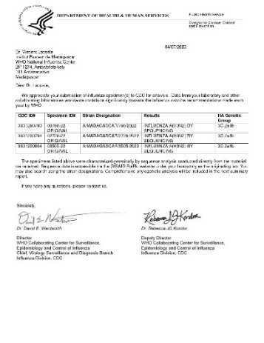
Sharing and reporting (International)
Weekly report of data to RespiMart
Flunet (lab data) by NIC
FluID (Epi data) by MoH
PISA by NIC
Weekly report to GIHSN (Epi and lab data)
Shipment of specimens to WHO CC
4 seasonal shipments per year for Flu
Shipment of RSV samples if required
Shipment of avian Flu samples if required
Upload of genomic sequences on GISAID
Influenza, RSV, SARS-CoV-2

Slide 32

CHALLENGES

Slide 33
Challenges (1)
Sites
Work overload (need of dedicated staff for data)
Completeness of CRF
Delay in data entry in DHIS2
Frequent staff turnover
Lack of awareness of clinicians
Lack of motivation
Electricity and water supplies

Slide 34
Challenges (2)
EPI and data management
Ensure data quality
Difficulty to link Epi and Lab data (interoperability system)
Insufficient HR (only 3 people from EPI-RC)
Insufficient IT equipment for data management

Slide 35
Challenges (3)
Lab
Delays in supplies, reagents and equipment procurement
Delays in reporting results (depending on priority disease and response)
Limited access to advanced diagnostic tools
Maintenance of equipment (need continuous funding)
Challenge of international shipment procedure

Slide 36
Challenges (4)
Lab Sequencing
Infrastructure and equipment
Unstable power supplies; slow connexion (internet)
Outdating of equipment and reagents (e.g Illumina) – need to renew
Cost of reagents (eg. Illumina)
Limited capacity on NGS sequencing (in terms of reagents)
Obtain sufficient materials for genetic sequencing
Limited qualified personnel

Slide 37
Challenges (5)
Other challenges
Sustainability of fundings (Funding dependance from external partners/donors (ex. CDC coag)
Limited support from government
Lack of fluid communication
Insufficient capacity buildings
Lack of routine refresh trainings

